Slide 1

Japan–Sri Lanka Partnership In Education And Research - 2025
“Transforming Knowledge into Action: A Japan–Sri Lanka Development Perspective”
Title of the Abstract
Name of Author ^{1*} , Name of Author²
Affiliation ^{1*}, Affiliation²

Slide 2
General Tips
Duration: 8 minutes presentation + 2 minutes Q&A
Slides: Maximum 8 (quality over quantity)
Fonts:
  Title: 30–35 pt (Arial Heading)
  Text: 20–25 pt
Keep it simple: no more than 6 lines per slide, 6 words per line
Avoid all CAPITAL LETTERS (hard to read)
Proofread carefully (spelling & grammar

Slide 3
Introduction / Background
Context: Explain the broader area of study (e.g., “Higher education in Sri Lanka faces challenges in digital adoption”).
Problem/Gaps: Highlight what is missing (e.g., “Limited integration of AI tools in university teaching”).
Importance: Why this research matters (e.g., “Improving digital literacy enhances employability and innovation”).

Slide 4
Example for Introduction
Introduction / Background
Technology is changing education worldwide.
Many universities still use traditional teaching methods.
Students need both IT skills and global exposure.
This study explores how Japan–Sri Lanka partnerships can help.

Slide 5
Research Problem / Objectives
Current issue: What gap exists?
Why this problem is important for your field.
How addressing it will create value.
Examples
To evaluate how IT + Japanese language integration improves employability.
To identify skills gaps faced by undergraduates in Sri Lanka.
To recommend strategies for Japan–Sri Lanka academic partnerships.

Slide 6
Methodology
Present the process, not the full details (audience doesn’t need a full paper).
Use flowcharts, diagrams, or icons instead of long text.
Focus on:
Study design / framework
Participants / sample
Tools / instruments used
Data collection & analysis

Slide 7
Example for methodology
Methodology
Study Design: Mixed-method approach (survey + interviews).
Participants: 120 undergraduates (IT & Japanese language streams).
Data Collection: Online questionnaire + focus groups.
Analysis: Descriptive statistics & thematic coding.

Slide 8
Results & Findings
Show only 2–3 main findings (not all raw data).
Prefer graphs, charts, or tables over text.
Use callouts/highlights to show trends or comparisons.
Keep captions consistent:
Figure = charts/graphs
Table = tabular data

Slide 9
Example for Results and Findings
Results & Findings
Finding 1: Majority of students improved Japanese proficiency after 1 year.
Finding 2: IT skills correlated strongly with internship opportunities.
Finding 3: 75% of graduates secured interviews with Japanese companies.

Slide 10
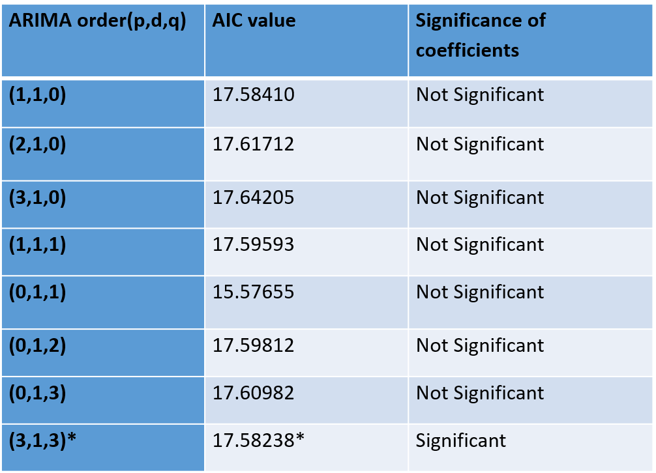
Findings
Table 01: (Title) (Calibri font - size 18)
Figure 01 : (caption) (Calibri font - size 18)

Slide 11
Discussion and Conclusion
Use 2 parts:
Discussion (what the results mean)
Conclusion (the final takeaway)
Limit to 4–5 short bullets total.
Keep each bullet to one clear idea.

Slide 12
Example
Discussion and Conclusion
Discussion
Bilingual IT training improves both technical and cultural readiness.
Results align with similar Asian university studies.
Unique contribution: Japan–Sri Lanka collaboration provides a new model.
Conclusion
Integrated IT + Japanese language training creates globally employable graduates.
Strong academic–industry partnerships accelerate student success.

Slide 13
Future Work
Suggest 1–2 realistic next steps.
Keep it forward-looking and practical.
Use action-oriented words (investigate, expand, implement).
Add 1–2 recommendations or next steps

Slide 14
Example for future work
Future Work
Investigate long-term career outcomes of graduates after 5 years.
Expand collaboration to include more Japanese universities and industries.
Develop AI-based tools to further support bilingual learning.

Slide 15
THANK YOU ! Q &A

Slide 16
Additional Formatting & Delivery Tips
Images: Ensure high resolution; avoid pixelated visuals
Animations: Keep minimal and professional
Time Management: ~1 min per slide
Practice: Rehearse 2–3 times to stay within 8 minutes
  Speak slowly, face audience (not screen).
  Handle Q&A politely (repeat question before answering).

Slide 17
Technical Instructions
  File naming convention: TrackSession_Lastname_Papernumber.pptx
  Submission deadline (to organizers)
  Backup instructions (USB)

